Slide 1
British History

Slide 2
Things that have
happened
in our past...

Slide 3

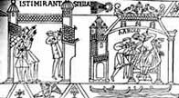
The Normans
Bayeux Tapestry
1070
Battle of Hastings
1066
1066 - 1154

Slide 4
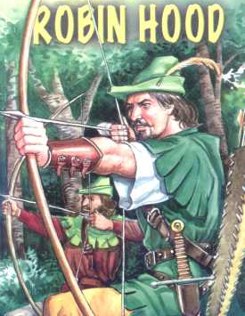
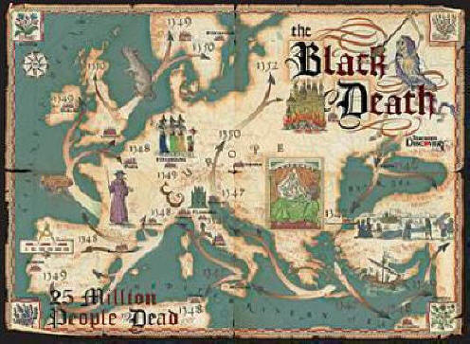
The Middle Ages
The Black Death
1347
Robin Hood 1261
1154 - 1485

Slide 5
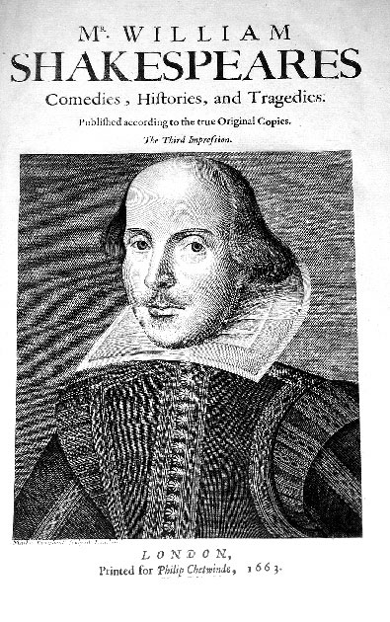
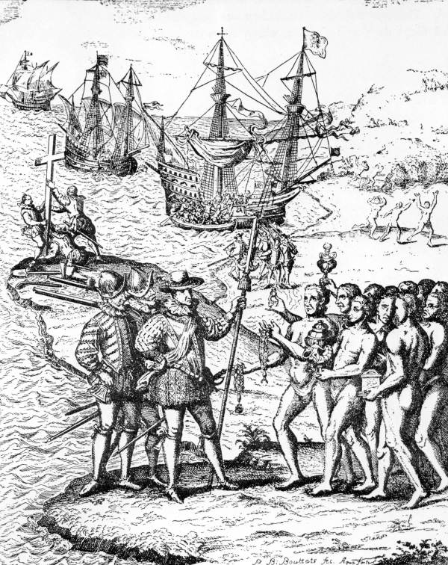
The Tudors
Christopher Columbus 1492
William Shakespeare
1564
1485 - 1603

Slide 6
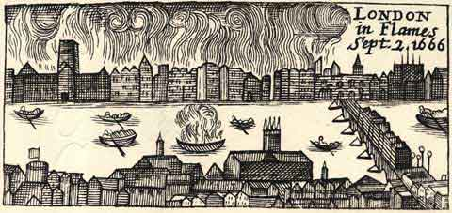
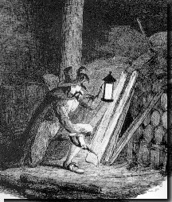
The Civil War
Great Fire of London
1666
Gunpowder Plot
1605
1603 - 1714

Slide 7
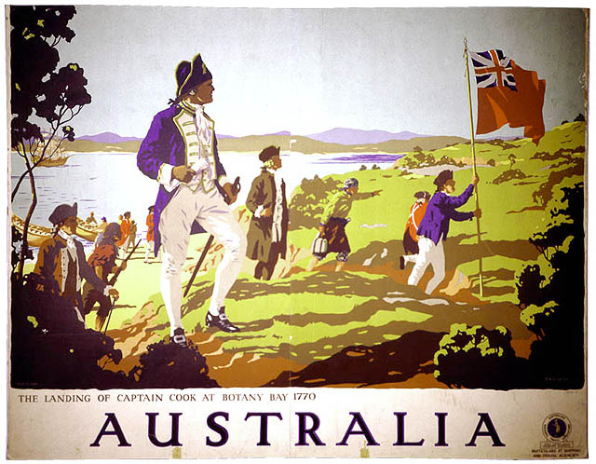
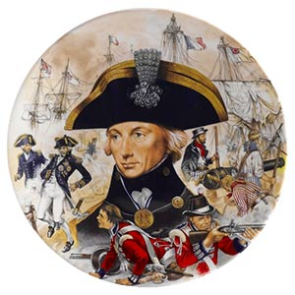
Empire & Sea Power
Battle of Trafalgar
1805
Captain Cook
1761
1714 - 1837

Slide 8
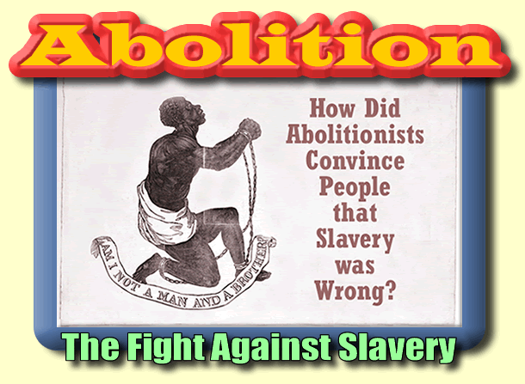
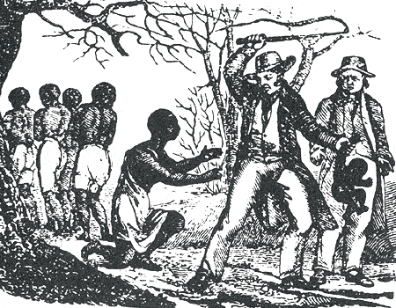
Abolition
The end of Slavery!
Slavery...
1807

Slide 9
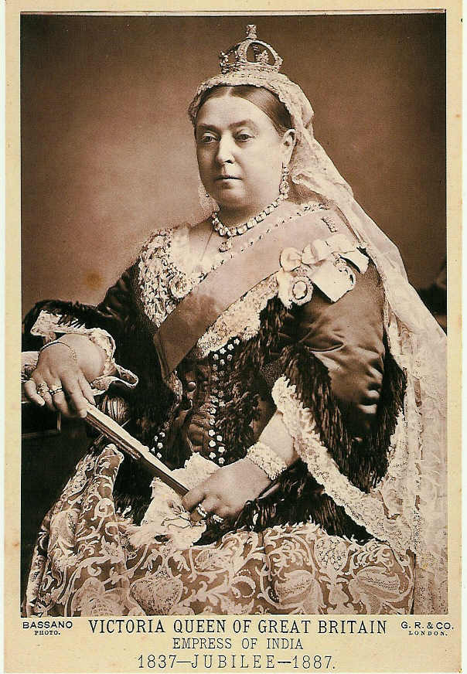
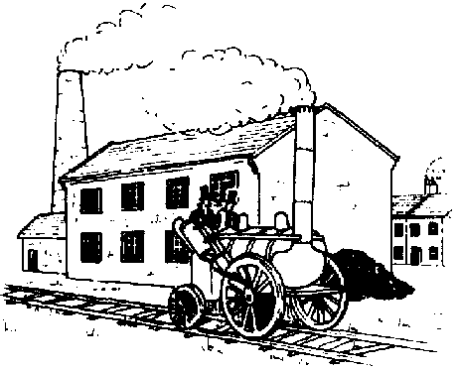
The Victorians
Industrial Revolution
Queen Victoria
1837 - 1901

Slide 10
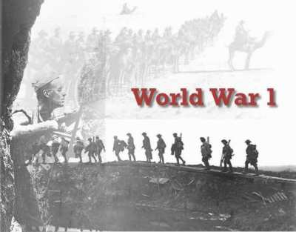
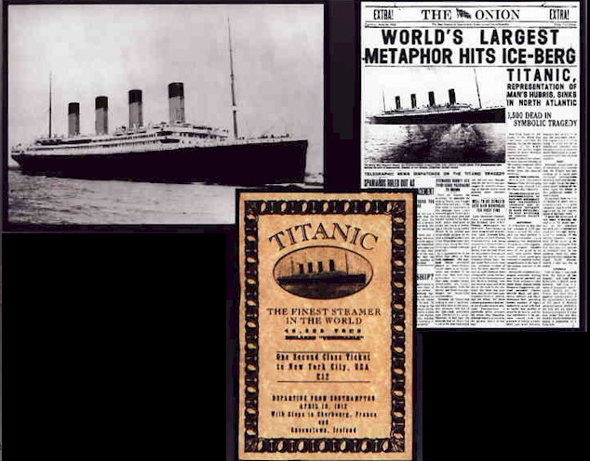
World Wars
World War I
1914-1918
The Titanic
1912
1901 - 1945

Slide 11
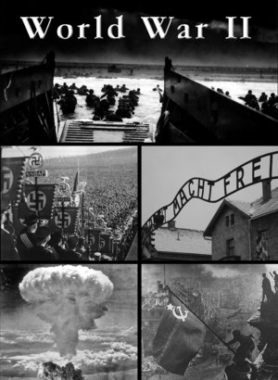

World Wars
World War II
World War II
1939-1945
1901 - 1945

Slide 12
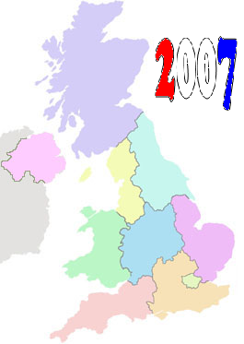
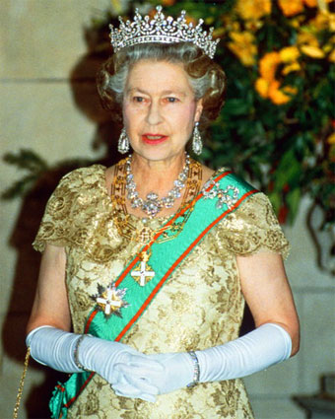
Modern Britain
Here and now!
Queen Elizabeth II
1953
1945 - 2007

Slide 13
Now it's time
for you to
do a Timeline

Slide 14
Middle
Ages
World War I
The
Normans
Civil
War
Abolition
1807
2007
The
Tudors
The
Victorians
World War II
Empire &
Sea Power

Slide 15
Decide which pictures
you are
putting where...

Slide 16
But for 2007...
You do your own
picture!

Slide 17
This powerpoint was kindly donated to www.worldofteaching.com
http://www.worldofteaching.com is home to over a thousand powerpoints submitted by teachers. This is a completely free site and requires no registration. Please visit and I hope it will help in your teaching.

